Slide 1

DETAILED COURSE PLAN
Artificial Intelligence Machine Learning
CSET301
Faculty:
Dr. Akansha Singh
Dr. Nitin A Shelke
Dr. Sujit Das
Dr. Rajnish

Slide 2
Evaluation Policy
Midterm | 10
End Semester Examination | 25
Continuous Lab Evaluation | 40
Quiz | 5
Project Demonstration | 20
Project Report | 0
Total | 100

Slide 3
Lab Experiments
Experiments will be case study based.
Project will be done in Hackathon.
Continuous Evaluation 2 marks per lab
Bonus Question after every two weeks.
Leader Board will be maintained, and students will get rewarded.

Slide 4

Lab Tools
Python
Anaconda
Google colab

Slide 5

MOOC course
Introduction to Artificial Intelligence (AI) (https://www.coursera.org/learn/introduction-to-ai)
IBM Machine Learning Professional Certificate
(https://www.coursera.org/professional-certificates/ibm-machine-learning)

Slide 6

Expert talk plan
Dr. Amit Sangroya, TCS Research and Innovation Labs, TATA Consultancy Services. Last week of August.

Slide 7
Course Path
Learning Systems
Supervised Learning Algorithms
ANN
Types of Machine Learning
Cost Functions , Learning Algorithms
Regression: Linear, Logistic and Polynomial
Performance Metrics
Decision Tree , Random Forest
Boosting, AdaBoost, Gradient Boost.
Feature Engineering , Feature Selection ,
Feature Extraction.
Perceptron model ,Multilayer perceptron model
Backpropagation Algorithm , Activation Functions
Regularization (Ridge, Lasso, Elastic)
Bayesian Learning ,The EM algorithm , Support Vector Machines
Unsupervised Learning Algorithms
Clustering : k-means clustering, Hierarchical DBSCAN, Cluster Quality
Association rule learning
Dimensionality reduction: Principal Component Analysis, Singular Vector Decomposition, T-distributed Stochastic Neighbor Embedding
Population Based Algorithms
Genetic Algorithm
Particle Swarm Optimization
Ant colony Algorithm
Deep Learning
Convolutional Neural Networks, Deep Learning for Sequential Data, Recurrent Neural Network, LSTM, GRU, Natural Language Processing, Word Embeddings, Transformers (BERT and GPT), Building and Deploying ML models (MLFlow), MLOps, Need of MLOps, ML Production Infrastructure.

Slide 8
Importance of the course
Students will get rigorous training on the fundamental concepts, algorithms, and theories in artificial intelligence and machine learning.
Articulate various supervised and unsupervised machine learning approaches.
Build and evaluate models generated from data.
Implement systems to solve real life problem using AI and Machine Learning approaches.

Slide 9
Machine Learning Importance
Machine learning has inserted itself into the fiber of our everyday lives – even without us noticing. Machine learning algorithms have been powering the world around us, and this includes
product recommendations at Shopping stores,
fraud detection at various top-notch financial institutions,
surge pricing at Uber,
Content used by LinkedIn, Facebook, Instagram, and Twitter on users’ feeds,
and these are just a few examples, grounded directly in the daily lives we live.

Slide 10
Advantages of Learning AIML

Slide 11

Better Career Opportunities and Growth
A report by TMR notes that MLaaS (Machine learning as a Service) is predicted to grow from to $19.9 billion by the end of 2025, from a mere $1.07 billion in 2016. This is a staggering amount of growth, both in absolute terms, as well as year-on-year.
It will take your career to another level.
It will make you part of something that is global as well as contemporary relevance.

Slide 12

Better Salaries
The best machine learning engineers these days are paid as much as immensely popular sports personalities!
And that’s no exaggeration!

Slide 13

Lack of Machine Learning Skills is Plaguing Corporations
Due to the number of jobs that have been created – and decreased, due to the fact that people are getting skilled in ML everyday. But the matter still remains, that the supply far exceeds the demand, in this scenario.

Slide 14


Slide 15


Slide 16
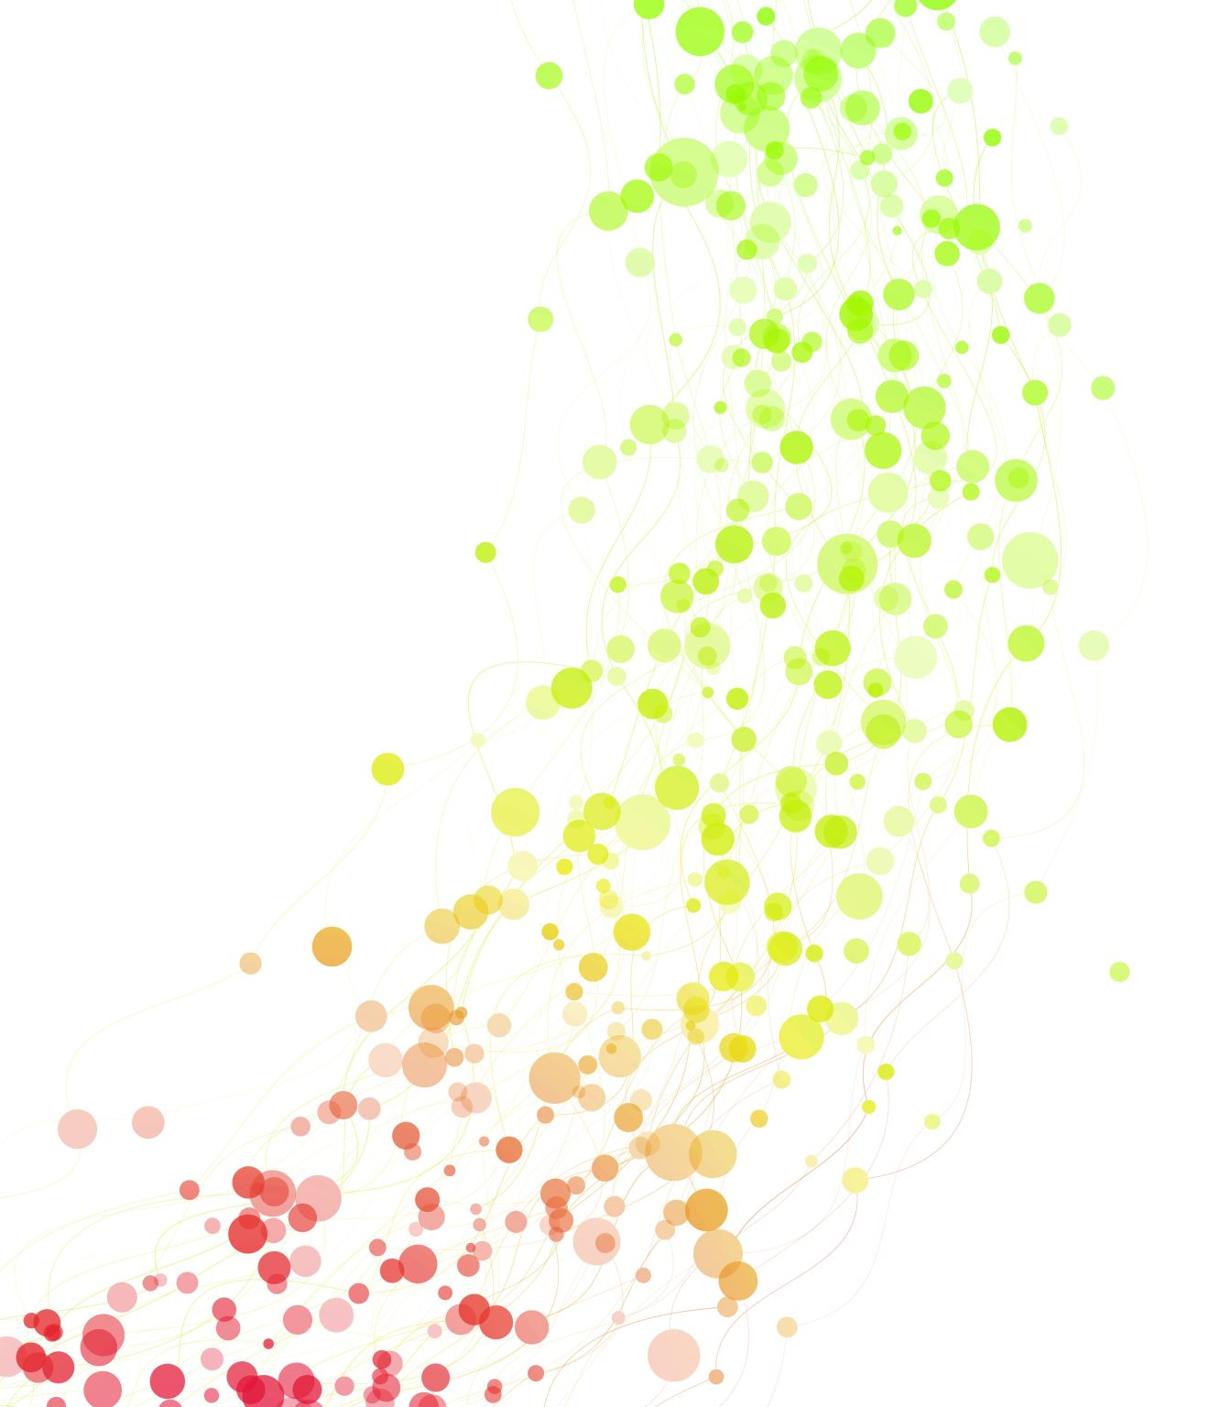
Good Luck and let’s enjoy learning how to make machines smarter!!

